Slide 1

Pinellas Secondary orientation
“Roaring Towards Success!”

Slide 2
Pinellas Secondary School
Vision – 100% student success
Mission – Educate and prepare each student for college/career and life.
Core Values - commitment to children, families and community; respectful and caring relationships; cultural competence; integrity; responsibility; connectedness
Philosophy – to provide a positive, proactive learning and supportive environment, with clearly delineated boundaries, for all students whom we serve. We believe that positive response to the challenges in the lives of our students is the best approach for success. Our goal is to help students navigate towards personal success by encouraging them to accept responsibility for their behavior in order to achieve academic success.

Slide 3
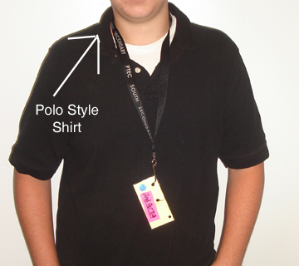
In Dress Code Polo Shirt
Student may wear only traditional, non-fitted, 100% cotton, solid polo style shirt.
These shirts must have NO pockets, printing, embroidery, or designs on them.
If you wear a undershirt it must be plain Black or white only, and both must be tucked in.
With long sleeves or full short sleeves (no cap sleeves).

Slide 4
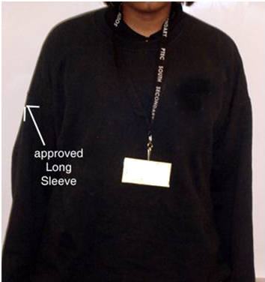
Sweatshirt
Only plain black sweatshirts for high school and white sweatshirts for middle school-with NO hoods, pockets, printing or design—may be worn in school.
You must be in dress code under your sweatshirt. White or black collared shirts must be visible.
Long sleeve t-shirts may be worn under the uniform shirts. Black t-shirts for high school and white t-shirts for middle school.
Jackets and coats are allowed but must be hung up on coat racks upon arrival to school. Students may retrieve jackets at the end of the day.

Slide 5
Pants: Dress Code
Only relaxed fit KHAKI pants are allowed. There may be NO -- printing, embroidery, logos, designs, Cargo pants, shorts, jeans, corduroy, spandex, jersey, skinny jeans, tight fitting pants or oversized pants.
Pants must have belt loops and a belt on at all times.
All pants must be hemmed and MUST be worn at the waist. No SAGGING!!

Slide 6
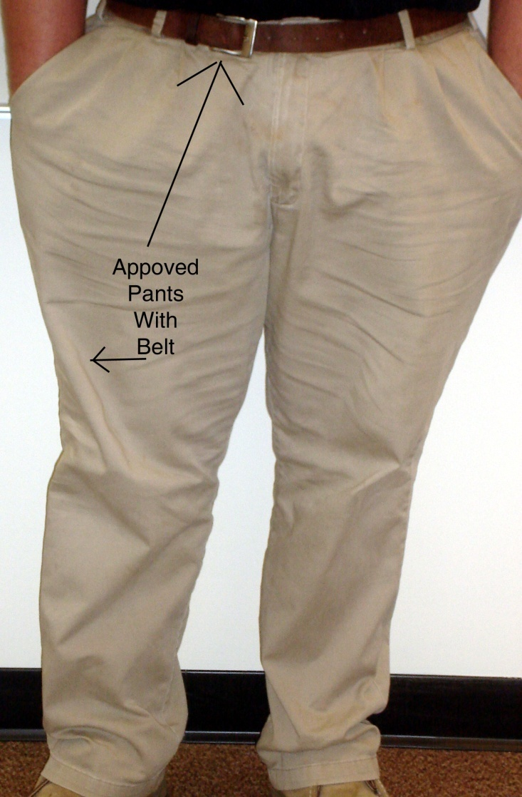
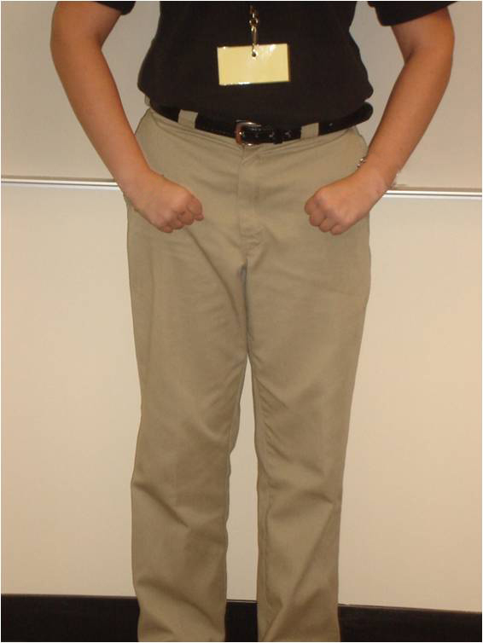
In dress code Khaki PANTS

Slide 7

Belt: Dress Code
A simple, plain BLACK or BROWN belt, with a simple, traditional buckle must be worn.
Except for buckle, there may be no other metal on the belt.
NO large or ornate belt buckles are allowed.

Slide 8
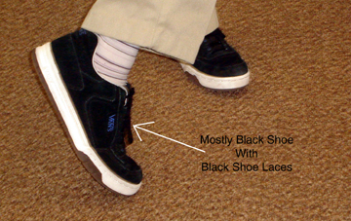
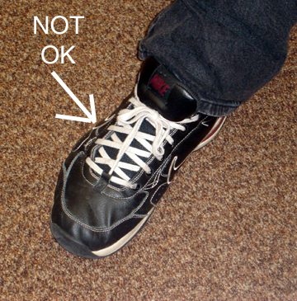
Shoes: Dress Code
Shoes must be black, white, gray or brown sneakers or dress shoes.
No sandals, slippers, boots or other work style shoes.
Laces should match the main color of the shoe (absolutely no colored laces)

Slide 9
ID Badges - - -
Students are required to wear an ID Badge as part of the Dress Code Policy. Each student will be given an ID Badge when they enroll into Pinellas Secondary School.
Lost, broken, destroyed, or defiled ID Badges must be replaced, to be in dress code compliance, at a charge of $1.00 each. Lanyards can also be purchased at a charge of $1.00 each.
***Students are not allowed in class without an
ID Badge.

Slide 10
Jewelry
Students may NOT wear or bring any rings, bracelets, necklaces, earrings, watches or any other jewelry to school. This includes tongue and face piercings and spacers/gauges, etc…
If a student brings any of these items to school, the items will be confiscated until the end of the day.

Slide 11
Electronic devices
School Board Policy concerning electronic devices is as follows:
  They are to be kept off and out of sight on school grounds
  If PSS students choose not to follow the district rule they will be subject to any and all of the following actions:
    Loss of item(s) until the end of the day
    If this becomes a repeated misconduct parent will be contacted for parent conference and suspension is a possibility.

Slide 12
NO Touch policy
Pinellas Secondary High is a NO TOUCH School
  This means no: hugging, putting hands on of any kind

Slide 13
What can you bring to school?
An open mind and a willingness to learn.
Pen, Pencil, Paper, Folders and a Binder.
Lunch in a clear plastic bag with your name on it. All drinks must be sealed.

Slide 14
What can’t you bring to school?
No BACKPACKS, PURSES, GYM BAGS,MAKE-UP or PENCIL BAGS
No GUM and SUNFLOWER SEEDS
No food or drinks allowed outside of cafeteria

Slide 15
Clinic Cards and Medication
Please make sure you list any illnesses your child may have
Please make sure you list any medications your child may need during the day
All Medication must be brought in by a Parent/Guardian; you will be required to sign necessary Consent Form.
Please make sure the prescription medication is in original RX bottle.

Slide 16
Homework
Mondays – Math
Tuesdays – Language Arts
Wednesdays – Social Studies
Thursdays – Science
Friday – Electives
* Days and frequency may change at the
teacher’s discretion.
* Homework Helpline - 727.547.7223
*

Slide 17

Title I
Purpose
Funding
Goal
Compact
Info
Volunteers
Surveys
Resources

Slide 18
Parent Portal
Parents/guardians can obtain information from Portal in relation to their child’s –
      Grades
      Attendance
      Discipline
      If you do not already have a PCS User ID and Password, you can sign-up for one today.

Slide 19
Tutoring
Tuesdays and Thursdays
1:40 – 3:40 PM at Pinellas Secondary School

Slide 20
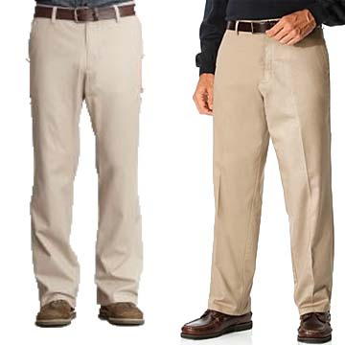
Relaxed Fit Khaki Pants

Slide 21

Shoes: black, brown, gray, or white

Slide 22

Proper Attire for Middle and High

Slide 23
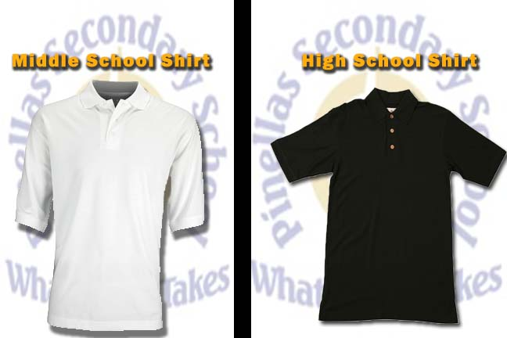
Polo Shirt: long or short sleeves

Slide 24

Thank You!
Q/A Time

